Slide 1
Lending Club Case Study
Submitted by:
Sravana Kumar Sanka
Jyoti Shukla

Slide 2
Index
Problem Statement
Data Cleaning & Imputing
Univariate Analysis
Bivariate Analysis
Multivariate Analysis
Correlation Analysis
Conclusion
Data Analysis

Slide 3
Problem Statement
A finance organization provides different loans to urban customers, faces a critical challenge in managing its loan approval process. When evaluating loan applications, the company must make informed decisions to minimize financial losses, which are primarily caused by lending to "risky" applicants.
Credit Losses occur when borrowers fail to repay their loans or default. In simple terms, borrowers labeled as "Charged-Off" are responsible for the largest financial losses to the company.
Goal of this analysis is to help LendingClub mitigate these credit losses. This challenge arises from two key scenarios:
Identifying applicants who are likely to repay their loans is crucial, as they can generate profits for the company through interest payments. Rejecting such applicants would lead to a loss of potential business.
Approving loans for applicants who are unlikely to repay and are at risk of default can result in substantial financial losses for the company.
The objective of this case study is to identify high-risk applicants who are likely to default, enabling the company to reduce credit losses. This will be achieved through Exploratory Data Analysis (EDA) using the provided dataset.
Ultimately, the company aims to understand the key drivers or predictive variables behind loan defaults—those factors that strongly indicate the likelihood of a borrower defaulting. By gaining insights into these drivers, the company can better assess its portfolio and evaluate risks more effectively.

Slide 4
Data Analysis
Loan Status: The Key Attribute of Interest (loan_status): The loan_status column contains three distinct values
Fully-Paid:
This indicates customers who have successfully repaid both the principal and interest of their loans.
This category includes applicants who have repaid both the principal and the interest in full.
Charged-Off:
This refers to customers who have defaulted on their loans, meaning they have been labeled as "Charged-Off.“
This classification applies to applicants who have failed to make timely payments over an extended period, resulting in the loan being considered in default.
Current:
This represents customers whose loans are still in progress. As such, there is no conclusive information about whether they will default in the future.
Applicants in this category are still actively repaying their loans, meaning the loan tenure has not yet concluded. These individuals are not classified as "defaulted."
For the purposes of this analysis, rows with a "Current" loan status will be excluded from the dataset, as they do not provide enough information to assess default risk.

Slide 5
Data Analysis(contd..)
Key Predictors of Loan Approval
The following attributes are crucial in predicting loan approval and rejection. These predictors are available during the loan application process. Note that some may be excluded due to missing data.
Loan applicants information:
Annual Income (annual_inc): Higher income generally increases loan approval chances.
Home Ownership (home_ownership): Owning a home offers collateral, improving approval odds.
Employment Length (emp_length): Longer employment tenure signals financial stability, boosting approval likelihood.
Debt to Income (dti): A lower DTI ratio increases the chances of loan approval.
State (addr_state): Location-based trends may reveal regional patterns related to defaults and delinquencies.
Loan Information:
Loan Amount (loan_amt): The requested loan amount.
Grade (grade): A rating based on creditworthiness, reflecting loan risk.
Term (term): Duration of the loan, typically in months.
Loan Date (issue_d): The date when the loan was issued.
Purpose of Loan (purpose): The reason for the loan, e.g., debt consolidation or home improvement.
Verification Status (verification_status): Indicates if the borrower's income has been verified.
Interest Rate (int_rate): Annual rate charged on the loan amount.
Installment (installment): Monthly repayment amount, including both principal and interest.
Public Records (public_rec): Derogatory records that increase loan risk, lowering approval chances.
Public Records Bankruptcy (public_rec_bankruptcy): Number of bankruptcy records, which negatively affect loan approval odds.

Slide 6
Data Analysis(contd..)
Exclusions in Our Analysis
For this analysis, we will exclude certain columns, which are categorized as follows. This list is not exhaustive, but it highlights the key exclusions:
Customer Behavior Columns
Columns related to customer behavior post-loan approval will not be considered, as our focus is on the loan application stage. These columns pertain to actions taken after loan approval and do not impact the loan decision.
Granular Data
We will omit highly detailed data that isn't necessary for this analysis. For example, the "sub grade" column provides excessive detail compared to the "grade" column, which is more relevant to our analysis.
Columns with Missing Data
54 columns containing only missing values (NA) will be removed, such as: acc_open_past_24mths, annual_inc_joint, avg_cur_bal, bc_util, dti_joint, mths_since_last_major_derog, etc.
Columns Containing Only Zero Values
Any columns with all zero values will be dropped as they do not provide useful information.
Single-Value Columns
9 columns with a single value across all records will be removed, as they don't contribute to the analysis.

Slide 7
Data Analysis(contd..)
Constant Columns with NA Values
Columns that contain a single value but have NA values for the rest will be treated as constant and will be dropped.
Columns with High Proportion of Missing Data
Columns where more than 65% of the data is missing (e.g., mths_since_last_delinq, mths_since_last_record) will be dropped.
Index and Descriptive Columns
Columns like id and member_id are unique index variables and do not contribute to the analysis, so they will be dropped.
Descriptive text columns such as emp_title, desc, and title will be excluded, as they contain textual data not relevant for the analysis.
Redundant URL Column
The url column will be dropped, as it is redundant—containing static information with the loan ID appended as a query, which is already captured
by the id column.
Missing Data in Key Columns
660 records for pub_rec_bankruptcies with missing values will be dropped.
Customer Behavior After Loan Approval
Columns capturing customer behavior after loan approval, such as payment history or account status updates, will not be included in the analysis as
they are not available during the loan approval process.
Other Columns to be Dropped:
Columns like delinq_2yrs, earliest_cr_line, inq_last_6mths, open_acc, pub_rec, revol_bal, and others related to post-approval loan performance
or recovery processes will also be excluded.

Slide 8
Data Cleaning & Imputing
1. Data Loading, Data Analysis, Data Cleaning , Data Manipulation
A. Declaring Mandatory Libraries B. Read CSV data into data frame C. Removal of null values from the dataset D. Removal of rows which has unique values in dataset E. Removal of duplicate rows in dataset F. Dropping un-necessary rows G. Data Conversion H. Handling OutLiers I. Imputing Data

Slide 9
Data Cleaning & Imputing(Cont..)
A. Declaring Mandatory Libraries : Used all mandatory libraries to load/modify the data
B. Read CSV data into data frame : While loading the dataset, some of the variables had mixed datatypes so they have to be converted accordingly as per analysis.
C. Removal of null values from the dataset : There’re many columns with null values. So they had to be dropped as they
won’t play a role in the analysis of the dataset. Roughly 48% of the columns were dropped.
D. Removal of rows which has unique values in dataset : If the column has only a single unique value, it does not make any sense to include it as part of our data analysis. We need to find out those columns and drop them from the dataset. 9 columns had such unique values and they were removed.
E. Removal of duplicate rows in dataset: No duplicate rows were found.
F. Dropping un-necessary rows:
Dropped records where loan_status=“Current” as the loan in progress cannot Provides us insights as to whether the borrower is likely to default or not.
Dropping columns where missing data is >=65% as these columns will skew our data analysis and they need to be removed.
Dropping extra columns containing text like collection_recovery_fee, delinq_2yrs, desc, earliest_cr_line, emp_title, id, inq_last_6mths, last_credit_pull_d, last_pymnt_amnt, last_pymnt_d, member_id, open_acc, out_prncp, out_prncp_inv, pub_rec, recoveries, revol_bal, revol_util, title, total_acc, total_pymnt, total_pymnt_inv, total_rec_int, total_rec_late_fee,
Total_rec_prncp, url, zip_codeas these will not contribute to loan pass or fail
G. Data Conversion: Converted columns like debt to income (dti), funded amount (funded_amnt), funded amount investor (funded_amnt_inv) and loan amount (loan_amnt) to float to match the data. Also converted loan date (issue_d)to DateTime(format: yyyy-mm-dd).

Slide 10
Data Cleaning & Imputing(Cont..)
H. Handling OutLiers: Calculated the Inter-Quartile Range (IQR) and filtering out the outliers outside of lower and upper bound. During Outlier analysis the following observations were made
Annual income of most of the loan applicants is between 40K -75K USD
Loan amount of most of the loan applicants is between 5K -15K
Funded amount of most of the loan applicants is between 5K -14K USD
Funded amount by investor for most of the loan applicants is between 5K -14K USD
Interest rate on the loan is between 9% -14%
Monthly installment amount on the loan is between 160 -440
Debt to income ration is between 8 -18
I. Imputing Data :
Replaced missing values in the annual_inc column with the mode value based on emp_length.
The emp_length column had 1,015 missing values, likely representing unemployed or self-employed (business owner) applicants.
Assumed the applicants with missing emp_length values are business owners and imputed the value as 10+ years, using the mode of the emp_length field.
Mapped emp_length values to the respective number of years in integer format.
Imputed missing NONE values in the home_ownership column as OTHER.
Replaced Source Verified values with Verified as both terms indicate the loan applicant’s income source is confirmed.
Dropped 660 rows with missing values in the pub_rec_bankruptcies column, as they couldn’t be reasonably imputed.
**After data cleaning and preprocessing, the dataset contains 36,094 rows and 19 columns

Slide 11
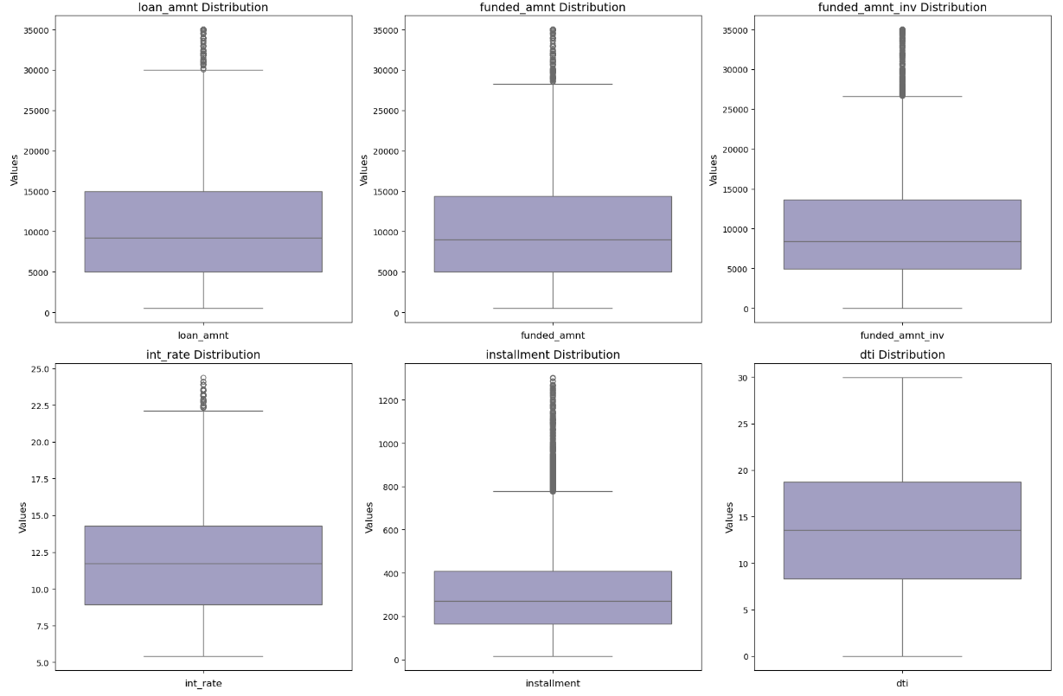
Data Cleaning & Imputing(Cont..)

Slide 12
Univariate Analysis
There are two main variables for any analysis, those are Categorial and Quantitative variables
Categorial Variables:
Quantitative Variables:
Interest rate bucket (int_rate_bucket)
Annual income bucket (annual_inc_bucket)
Loan amount bucket (loan_amnt_bucket)
Funded amount bucket (funded_amnt_bucket)
Debt to Income Ratio (DTI) bucket (dti_bucket)
Monthly Installment (installment)
Ordered | Unordered
Grade (grade) Sub grade (sub_grade) Term (36 / 60 months) (term) Employment length (emp_length) Issue year (issue_y) Issue month (issue_m) Issue quarter (issue_q) | Address State (addr_state) Loan purpose (purpose) Home Ownership (home_ownership) Loan status (loan_status) Loan paid (loan_paid)

Slide 13
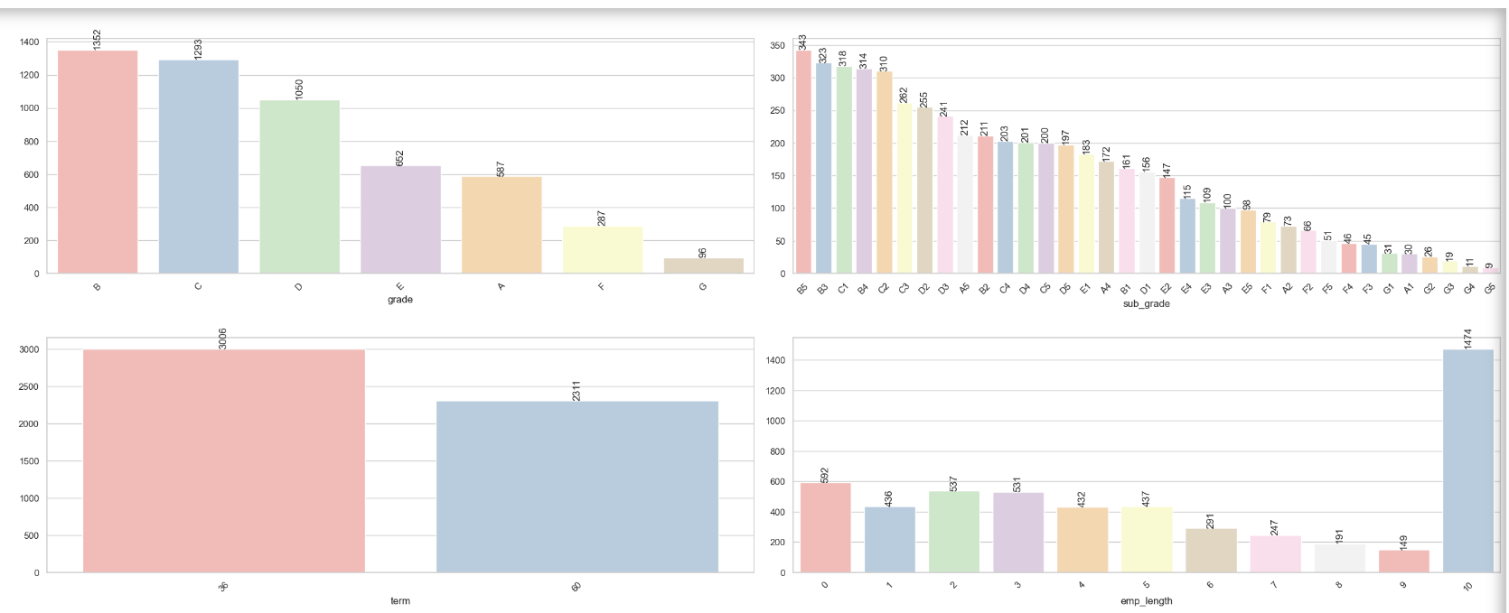
Univariate Analysis (Ordered Categorial)
Columns : Grade , Sub Grade, Term, Emp Length

Slide 14
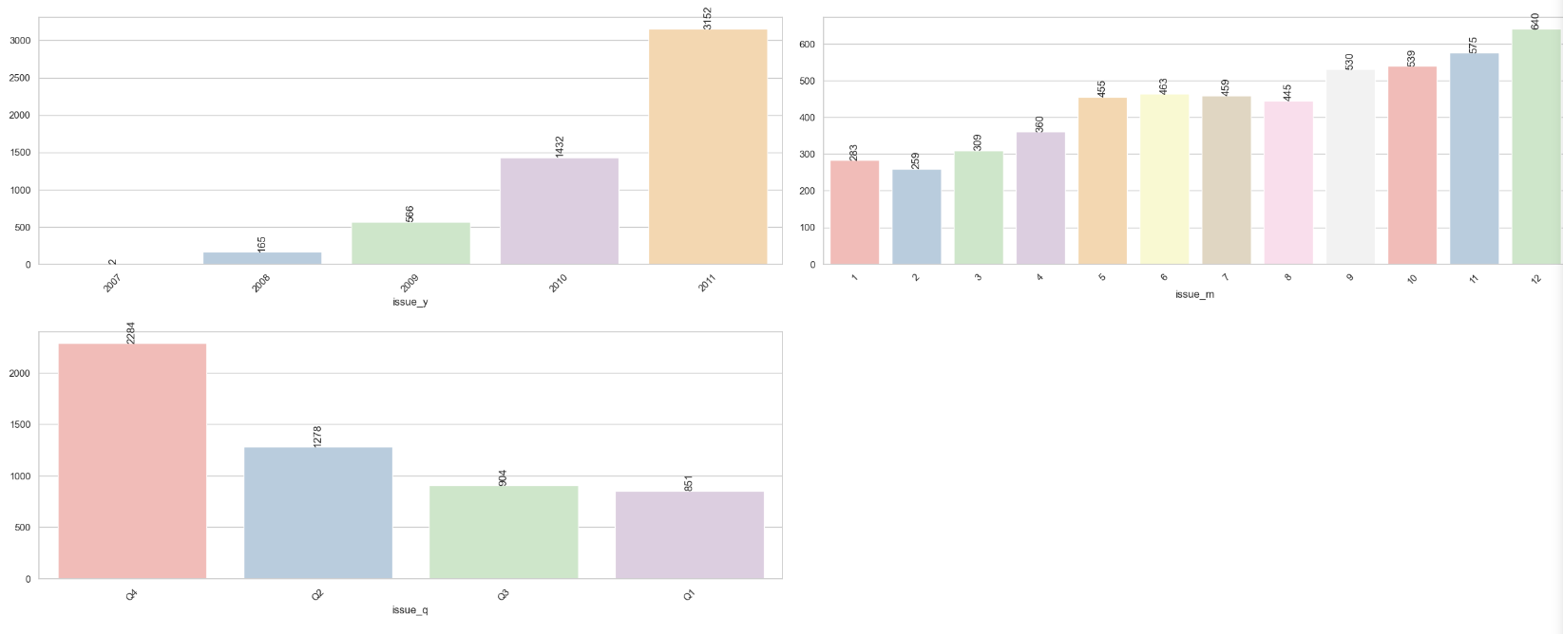
Univariate Analysis (Ordered Categorial)
Columns : issue_y , issue_m, term, issue_q

Slide 15
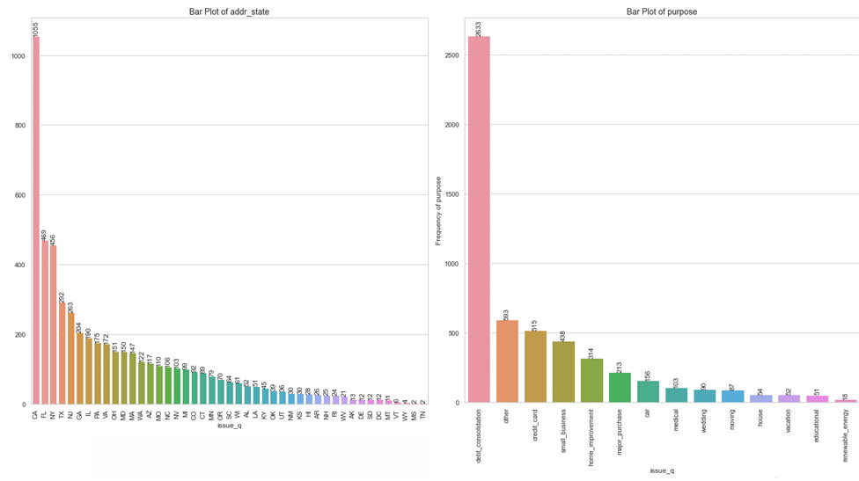
Univariate Analysis (Unordered Categorial)
Columns : addr_state, purpose

Slide 16
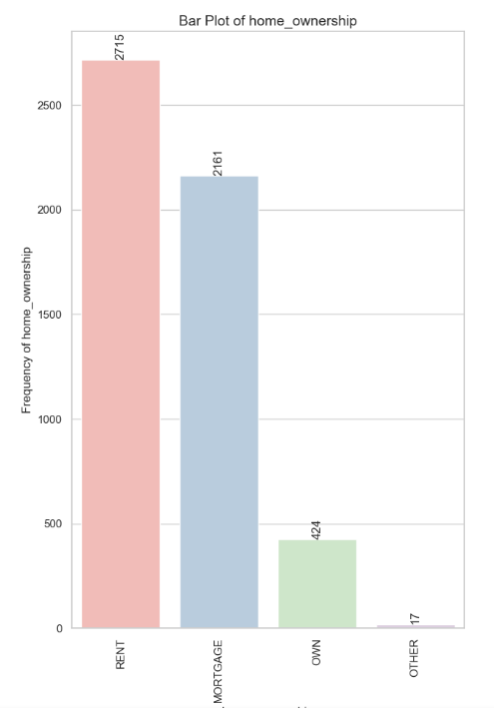
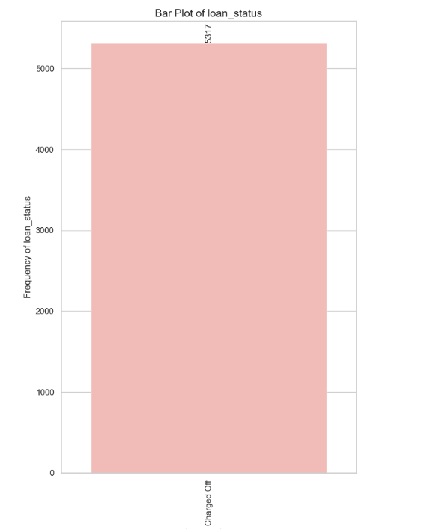
Univariate Analysis (Unordered Categorial)
Columns : home_ownership, loan_status

Slide 17
Univariate Analysis ( Categorial Variables)
Univariate Analysis Key Points and observations
Ordered Categorical Variables
Grade B exhibited the highest count of "Charged off" loan applicants, with 1,352 individuals, indicating that applicants with this credit grade struggled the most with repaying their loans.
Loans with a term of 36 months were the most common among those who defaulted, accounting for 3,006 applications. This suggests that a significant number of defaulters opted for shorter-term loans.
A large number of loan defaulters, specifically 1,474 individuals, had been employed for over 10 years. This highlights that a long employment history does not necessarily guarantee the successful repayment of loans.
The year 2011 saw the highest volume of "Charged off" loan applications, totaling 3,152, indicating a sharp increase in defaults during that period. This could be attributed to economic challenges or financial stress during that year.
The majority of "Charged off" loans were originated in the 4th quarter, with 2,284 applications, predominantly in December. This seasonal peak may be linked to heightened financial strain around the holidays, contributing to defaults.

Slide 18
Univariate Analysis ( Categorial Variables)
Unordered Categorical Variables
California led with the most "Charged off" loan applicants, with 1,055 defaulters. This suggests the need for the lending company to impose more rigorous eligibility checks or credit assessments in this state due to the higher default rate.
Debt consolidation was the leading purpose for loans among "Charged off" applicants, with 2,633 choosing this option. The lending company should exercise caution when approving loans for debt consolidation, as it was the most common reason for defaults.
The largest group of loan defaulters, comprising 2,715 individuals, resided in rented homes. The lending company should consider the financial stability of applicants in this group, as renters may be more vulnerable to economic downturns.
A significant portion, 5,317 individuals, were loan defaulters who were unable to repay their loans. The lending company needs to enhance its risk assessment procedures, including stricter credit evaluations and lower loan-to-value ratios, for individuals with a history of loan defaults. Offering financial literacy programs and support services could help improve repayment success.

Slide 19
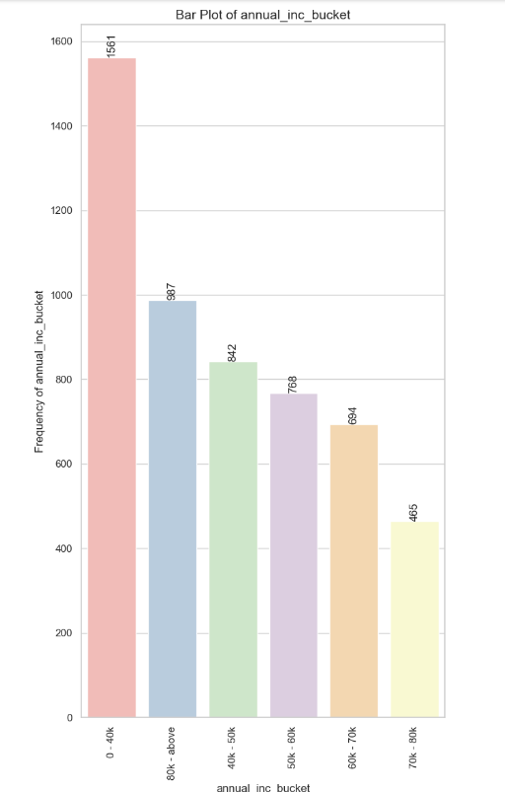
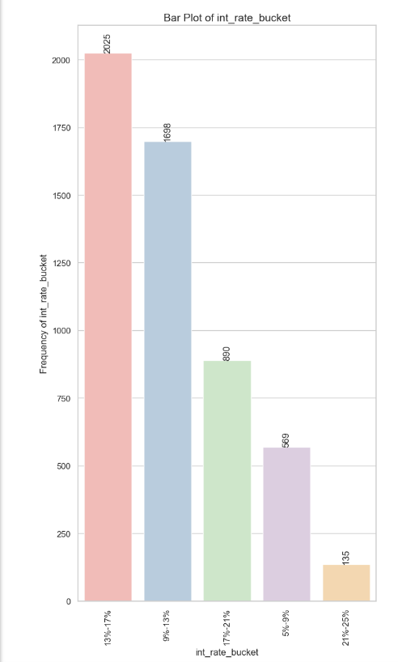
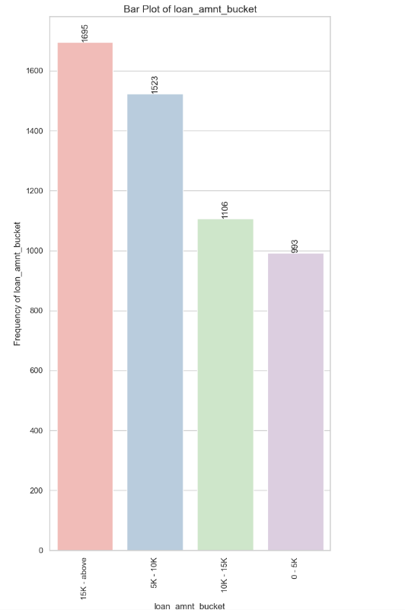
Univariate Analysis (Quantitative Variables)
Columns : annual_inc, int_rate_bucket, loan_amnt_bucket

Slide 20
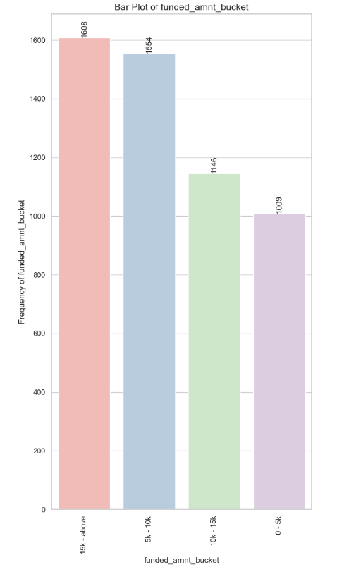
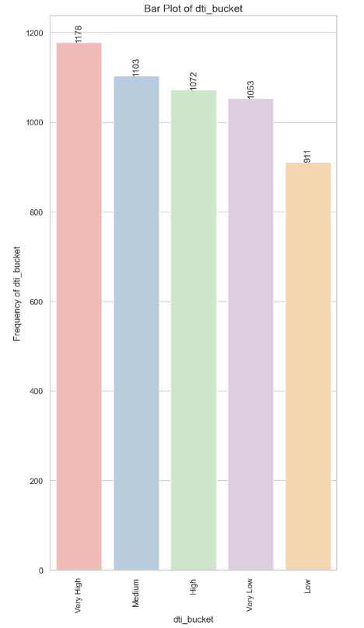
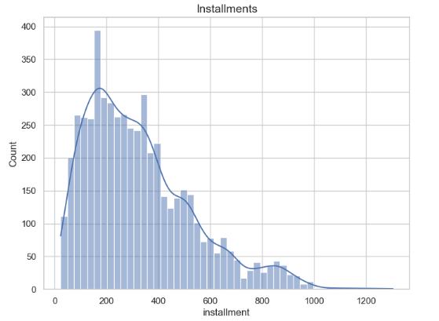
Univariate Analysis (Quantitative Variables)
Columns : funded_amnt_bucket, dti_bucket , installments

Slide 21
Univariate Analysis ( Quantitative Variables)
Quantitative Variables
1,561 applicants who defaulted on their loans had an annual income of less than 40,000 USD. The lending company should be more cautious when lending to individuals in this income range, ensuring thorough income verification and assessing repayment capacity more carefully.
A significant portion of loan defaulters, 2,025 individuals, were in the 13%-17% interest rate bucket. To reduce default risks, the lending company should explore offering loans at lower interest rates when feasible.
1,695 loan participants who charged off had loan amounts of 15,000 USD or more. The company should carefully evaluate loan applicants seeking larger amounts, ensuring they have a strong credit history and the financial ability to handle such loans.
1,608 loan defaulters rexceived funded amounts of 15,000 USD or more. The lending company should ensure that funded amounts are in line with the borrower's financial capacity, conducting more comprehensive credit assessments for larger loans.
Among the loan defaulters, 1,178 individuals had exceptionally high debt-to-income ratios. The lending company should impose strict debt-to-income ratio limits to avoid lending to borrowers who have unsustainable levels of debt relative to their income.
1,178 loan defaulters had monthly installments within the 160-440 USD range. The company should monitor applicants in this range closely, as they may be at higher risk of defaulting on their loans due to the installment amount.

Slide 22
Bivariate Analysis
Categorial Variables:
Quantitative Variables:
Interest rate bucket (int_rate_bucket)
Annual income bucket (annual_inc_bucket)
Loan amount bucket (loan_amnt_bucket)
Funded amount bucket (funded_amnt_bucket)
Debt to Income Ratio (DTI) bucket (dti_bucket)
Ordered | Unordered
Grade (grade) Sub grade (sub_grade) Term (36 / 60 months) (term) Employment length (emp_length) Issue year (issue_y) Issue month (issue_m) Issue quarter (issue_q) | Address State (addr_state) Loan purpose (purpose) Home Ownership (home_ownership) Verification Status (verification_status)

Slide 23
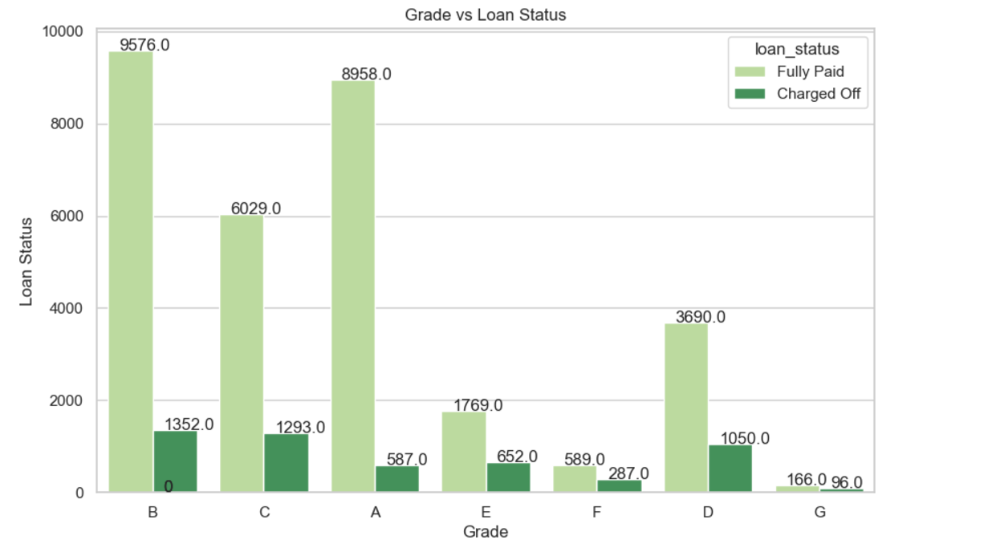
Bivariate Analysis(Ordered Categorical)

Slide 24
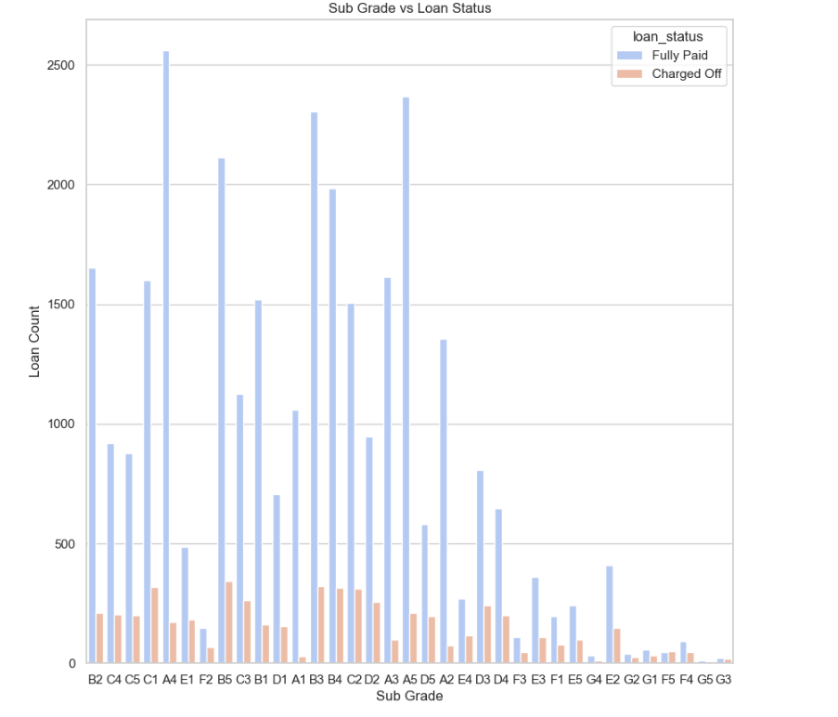
Bivariate Analysis(Ordered Categorical)

Slide 25
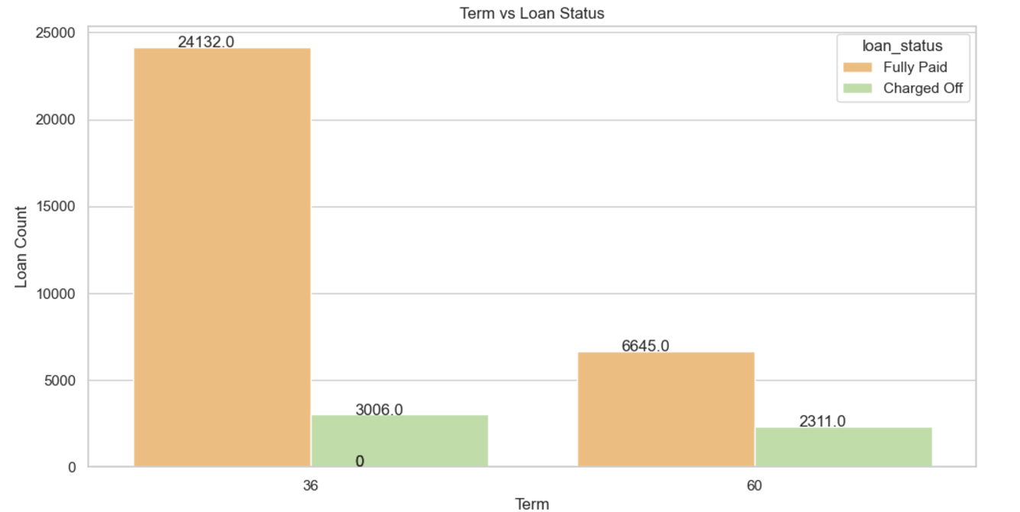
Bivariate Analysis(Ordered Categorical)

Slide 26
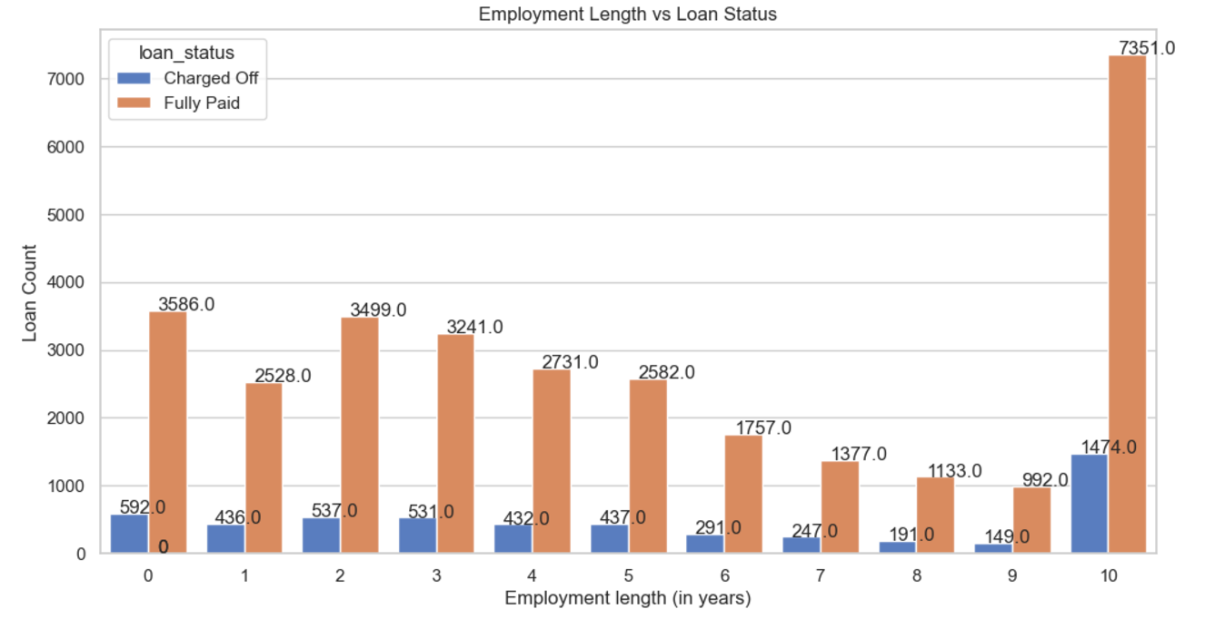
Bivariate Analysis(Ordered Categorical)

Slide 27
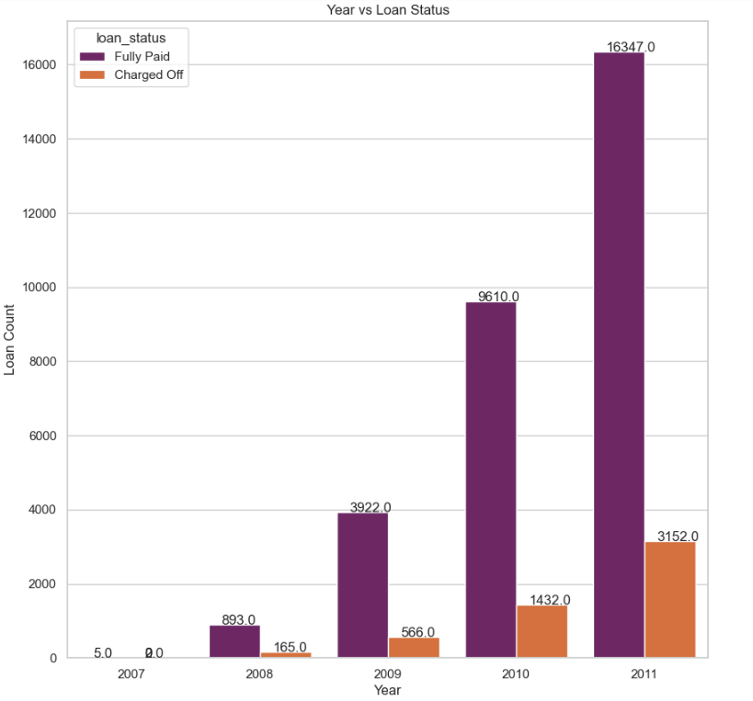
Bivariate Analysis(Ordered Categorical)

Slide 28
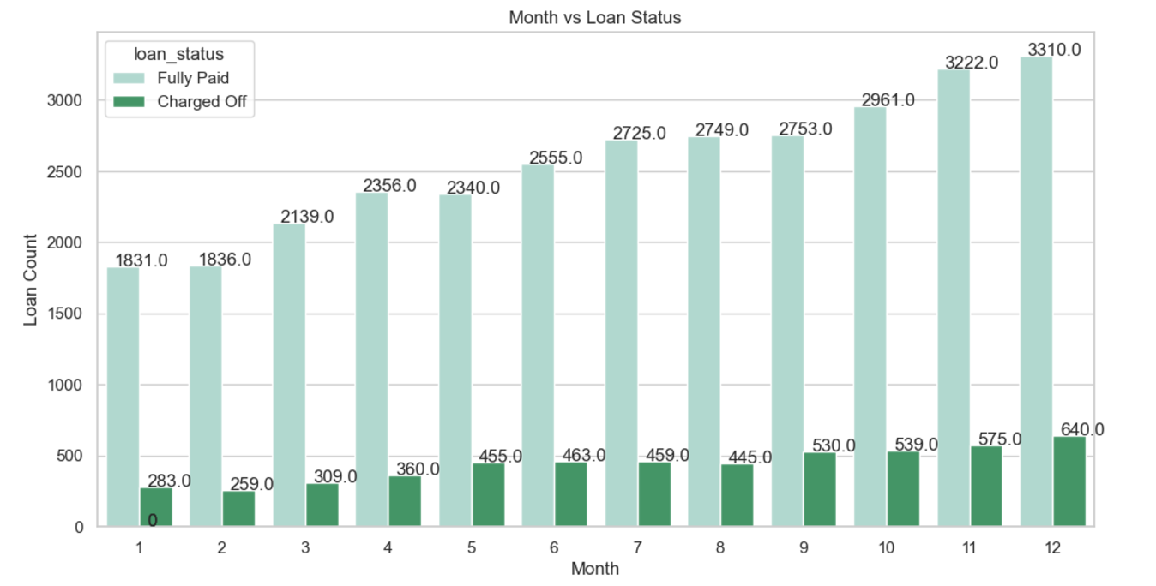
Bivariate Analysis(Ordered Categorical)

Slide 29
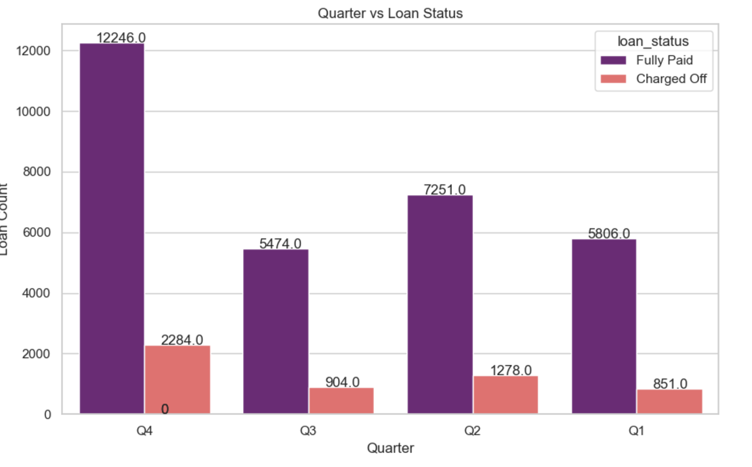
Bivariate Analysis(Ordered Categorical)

Slide 30
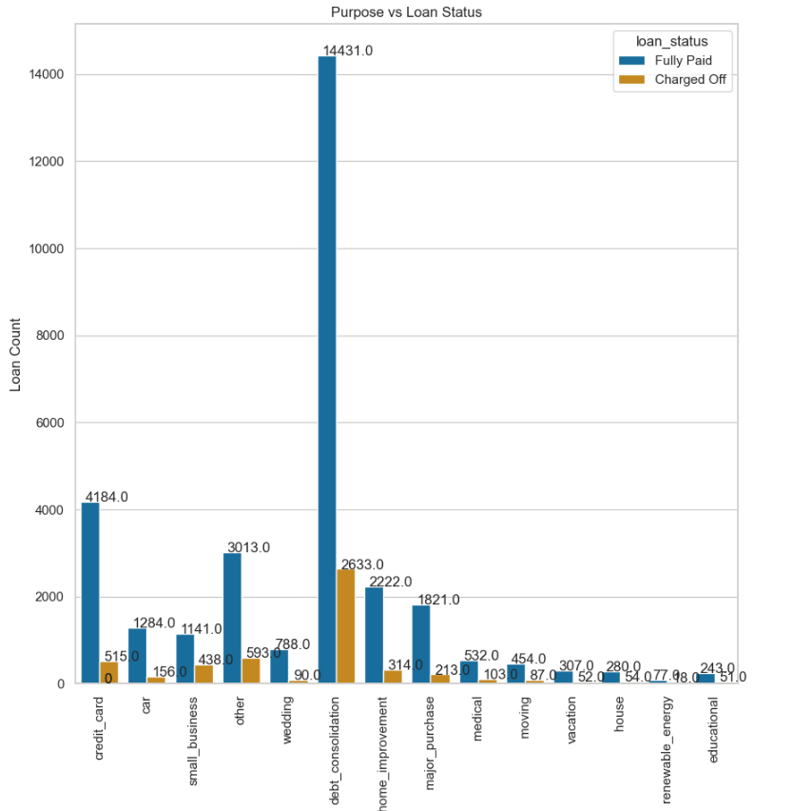
Bivariate Analysis(Unordered Categorical)

Slide 31
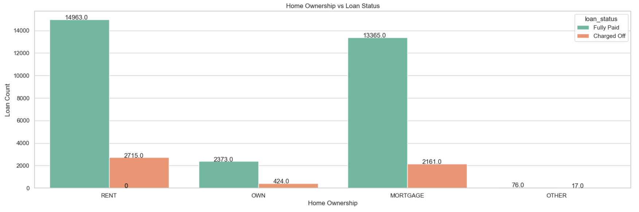
Bivariate Analysis(Unordered Categorical)

Slide 32
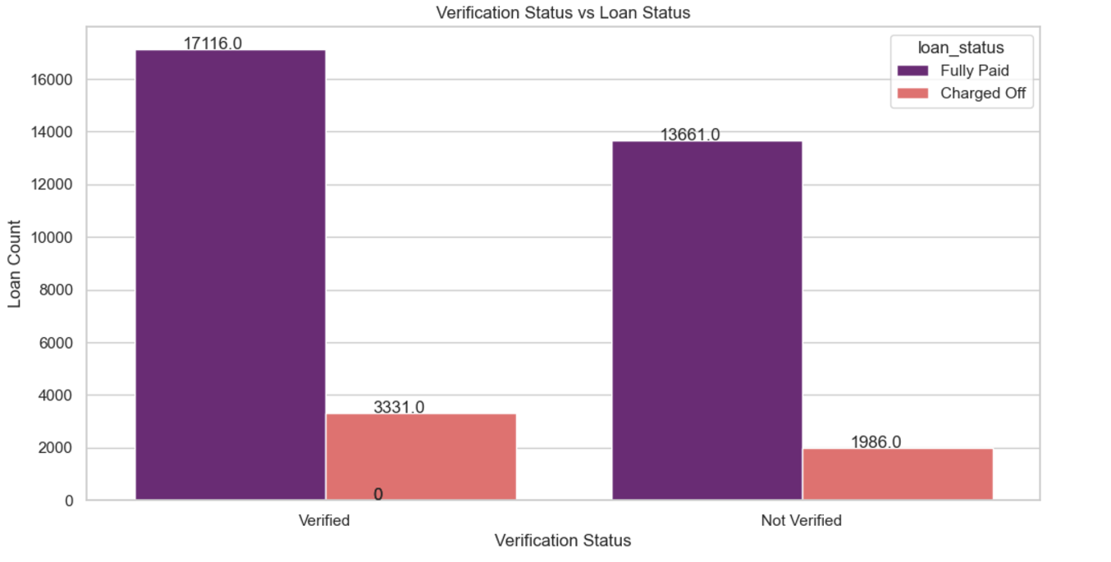
Bivariate Analysis(Unordered Categorical)

Slide 33
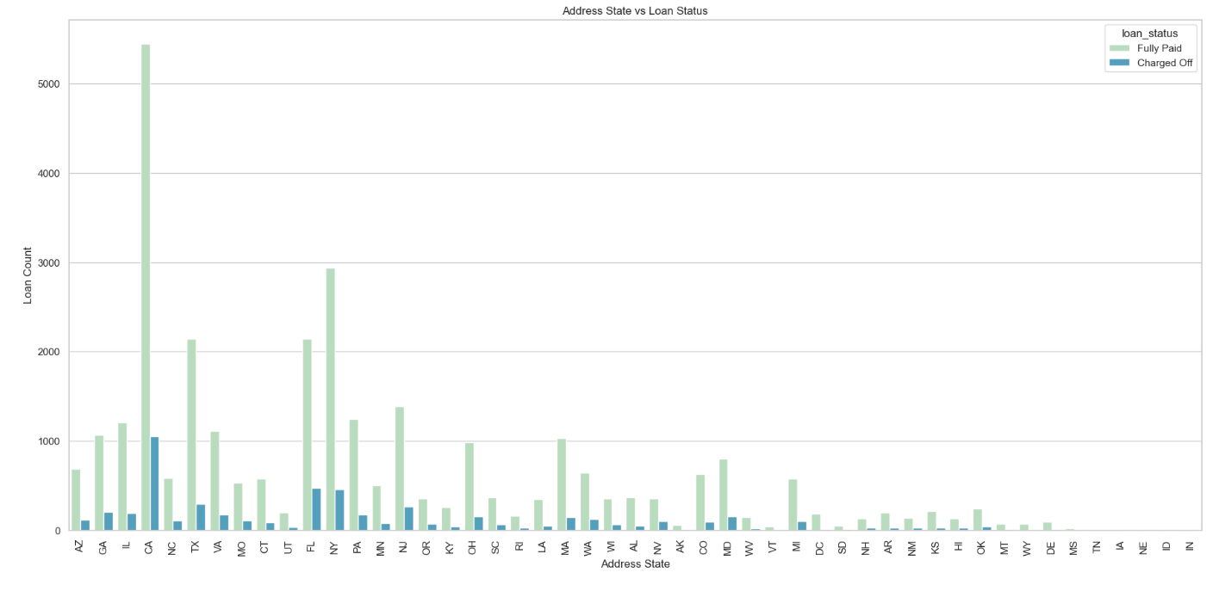
Bivariate Analysis(Unordered Categorical)

Slide 34
Bivariate Analysis(Categorical) - Insights
Ordered Categorical Variables:¶
The majority of "Charged Off" loans come from applicants in Grades B, C, and D.
Applicants in Sub Grades B3, B4, and B5 have a higher likelihood of defaulting.
Applicants who choose a 60-month loan term are more likely to default compared to those who select a 36-month term.
The largest group of loan applicants have Ten or more years of work experience, and this group also has the highest default rate.
The number of loan applicants has increased consistently from 2007 to 2011, suggesting a positive trend moving forward.
December is the month with the highest loan application rate, likely due to the holiday season.
The fourth quarter (Q4) sees the most loan applications, primarily due to the upcoming holiday season.
Unordered Categorical Variables:
Debt consolidation loans are both the most common type of loan issued and the category with the highest default rate.
Loan applicants who live in rented or mortgaged homes are more likely to default on their loans.
Verified loan applicants are defaulting more frequently than those who are unverified.
Loan applicants from California (CA), Florida (FL), and New York (NY) are more likely to default.

Slide 35
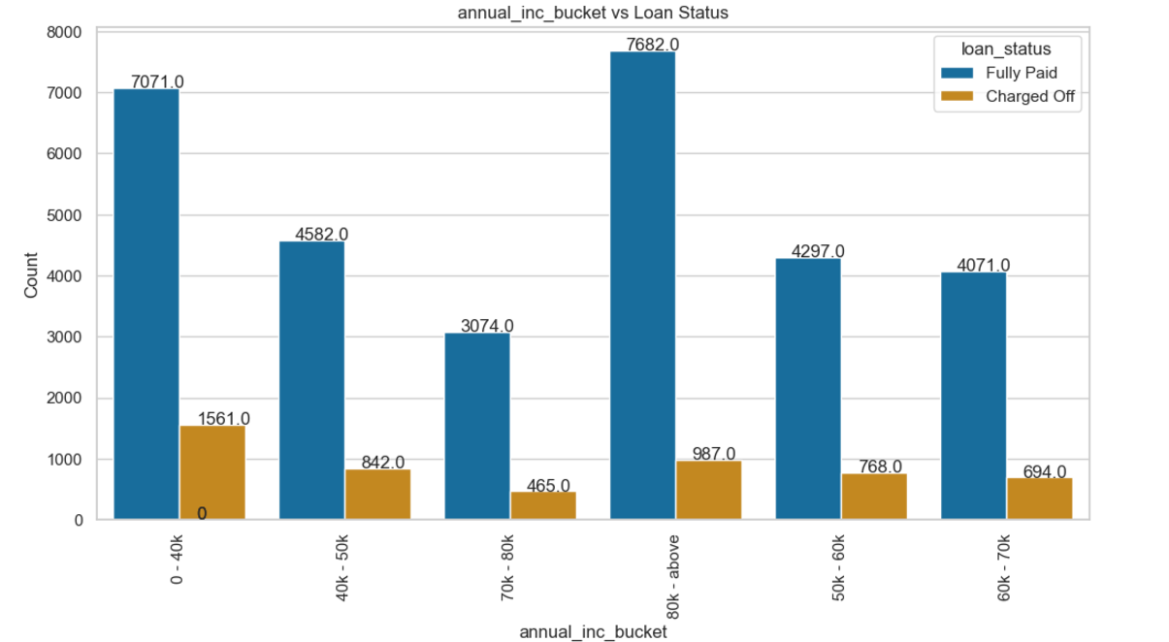
Bivariate Analysis(Quantitative Variable)

Slide 36
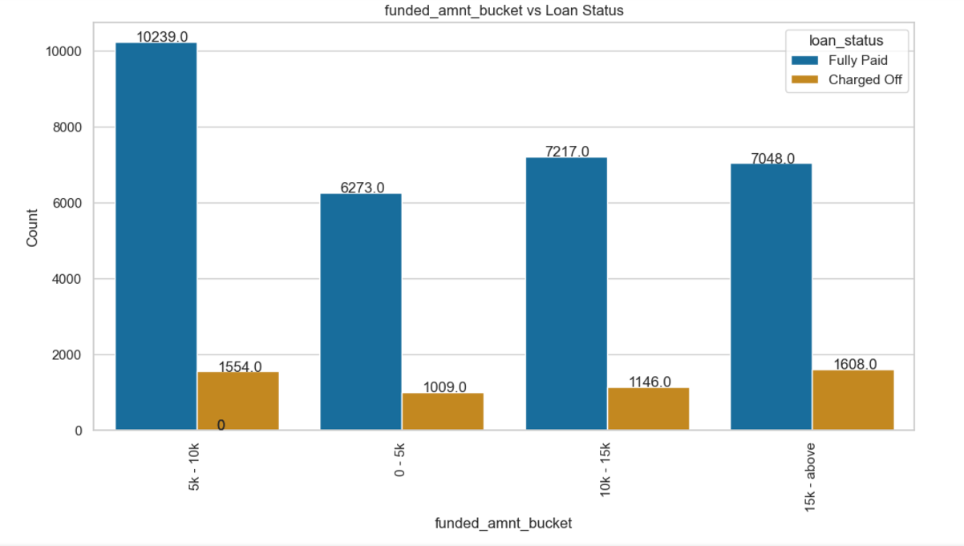
Bivariate Analysis(Quantitative Variable)

Slide 37
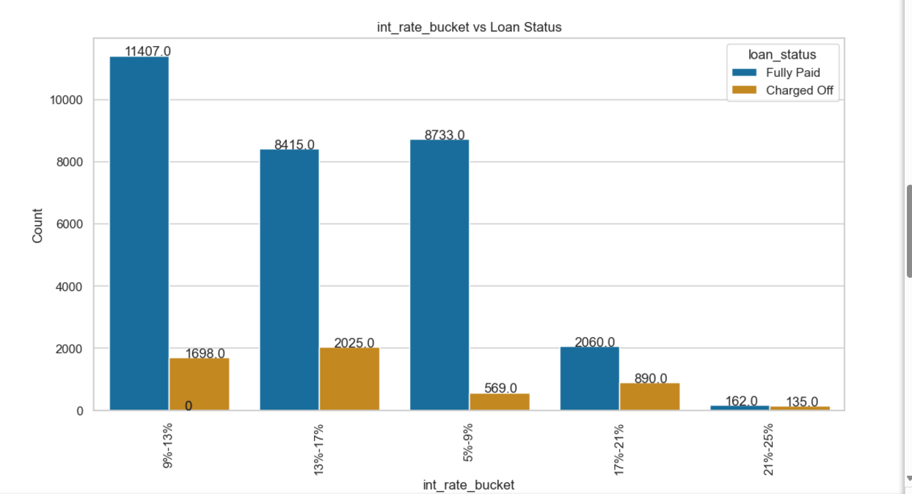
Bivariate Analysis(Quantitative Variable)

Slide 38
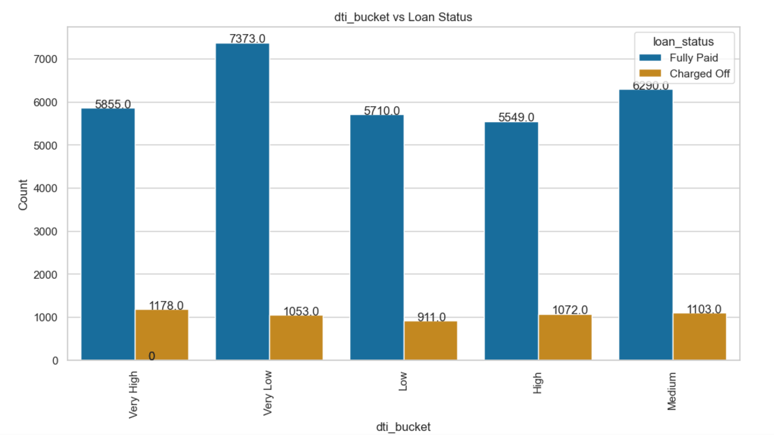
Bivariate Analysis(Quantitative Variable)

Slide 39
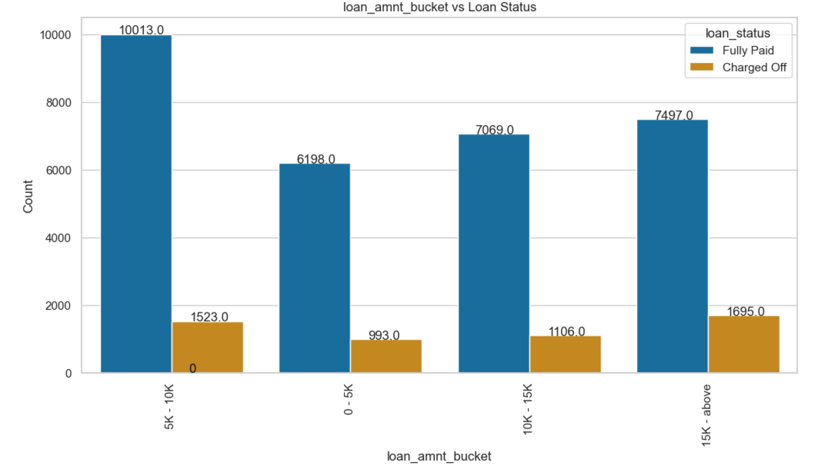
Bivariate Analysis(Quantitative Variable)

Slide 40
Bivariate Analysis(Quantitative) - Insights
Insights from Bivariate Analysis of Quantitative Variables
Most loan applicants who defaulted were granted loan amounts of $15,000 or more.
A large proportion of applicants who defaulted had very high Debt-to-Income (DTI) ratios.
A notable share of loan applicants who defaulted had interest rates between 13% and 17%.
The majority of loan applicants who charged off reported annual incomes below $40,000.

Slide 41
Bivariate Analysis - Inferences
Regional Default Risk: Loan applicants from states such as California (CA), Florida (FL), and New York (NY) have higher default rates. The company should monitor regional risk trends and consider adjusting its lending strategies or rates based on geographic risk factors.
Debt Consolidation Loan Risk: Since debt consolidation loans account for the highest number of loans issued and defaults, the company should carefully scrutinize applicants seeking debt consolidation loans. Adjusting interest rates or offering financial counseling services could help mitigate this risk.
Focus on Subgrades B3, B4, and B5: Special attention should be given to applicants in Subgrades B3, B4, and B5, as they exhibit a higher likelihood of charging off. Introducing additional risk mitigation strategies or offering lower loan amounts could be beneficial.
Debt-to-Income Ratio and Interest Rate Risk: High Debt-to-Income (DTI) ratios and interest rates between 13% and 17% are strongly associated with loan defaults. The company should consider revising its interest rate policies and ensure that rates are more aligned with the applicant's DTI ratio to reduce the risk of default.
Seasonal Loan Application Trends: December and the fourth quarter (Q4) see the highest volume of loan applications, likely due to the holiday season. The company should anticipate this surge in demand and ensure it has the capacity to process applications efficiently during these peak periods.
Loan Verification Process: Verified applicants have shown a higher default rate compared to unverified applicants. The company should review and improve its verification process to ensure it accurately evaluates the creditworthiness of applicants and take corrective measures where necessary.
Risk Evaluation for Grades B, C, and D: Since loan applicants from Grades B, C, and D are the main contributors to "Charged Off" loans, the company should consider applying more stringent risk assessment and underwriting criteria for applicants in these grades.

Slide 42
Bivariate Analysis - Inferences
High Loan Amount Risk: Applicants seeking loan amounts of $15,000 or more are more likely to default. To mitigate this risk, the company should conduct more rigorous assessments for larger loan requests and consider capping loan amounts for higher-risk applicants.
Housing Status and Default Likelihood: Applicants who live in rented or mortgaged homes tend to have a higher risk of defaulting. This information should be factored into the underwriting process to assess the stability of the applicant’s housing situation and its potential impact on their ability to repay the loan.
Loan Term Considerations: Given that applicants opting for 60-month loan terms tend to default more often, the company should assess the risks associated with longer loan durations and consider limiting maximum terms or adjusting interest rates accordingly.
Growth Trend in Loan Applications: The steady rise in loan applications from 2007 to 2011 reflects a growing market trend. The company can leverage this growth by maintaining a competitive position in the industry while strengthening its risk management practices.
Income Level and Default Probability: Applicants with an annual income of less than $40,000 are more likely to default. The company could offer financial education or set loan amount caps based on income levels to ensure loan affordability for applicants with lower incomes.
Experience and Default Risk: Loan applicants with 10 or more years of experience tend to have a higher likelihood of default. This suggests that experience alone may not be a reliable indicator of creditworthiness, prompting the need for a more holistic credit scoring system that accounts for other risk factors. s with lower incomes.

Slide 43
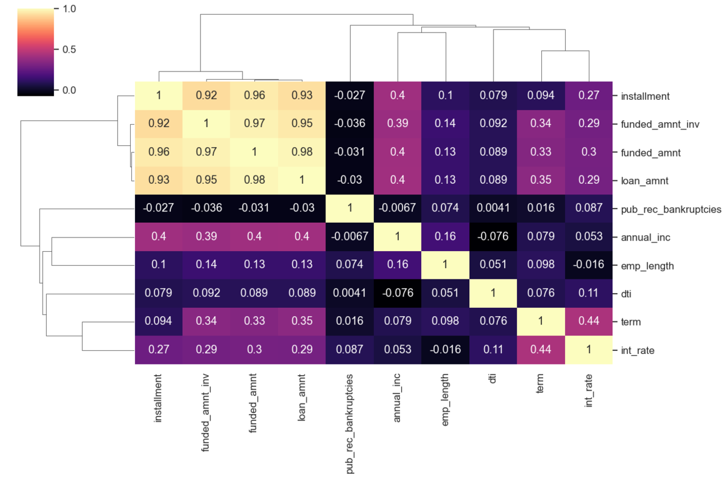
Correlation Analysis

Slide 44
Correlation Analysis - Insights
Inferences from Correlation Metrics
Strong Correlation
There is a significant correlation between installment and funded_amnt, loan_amnt, as well as funded_amnt_inv.
term shows a strong relationship with the interest rate.
annual_inc exhibits a notable correlation with loan_amnt.
Weak Correlation
dti displays a weak correlation with most other fields.
emp_length also shows a weak correlation with several other variables.
Negative Correlation
pub_rec_bankruptcies is negatively correlated with nearly all other fields.
annual_inc shows a negative correlation with dti.

Slide 45
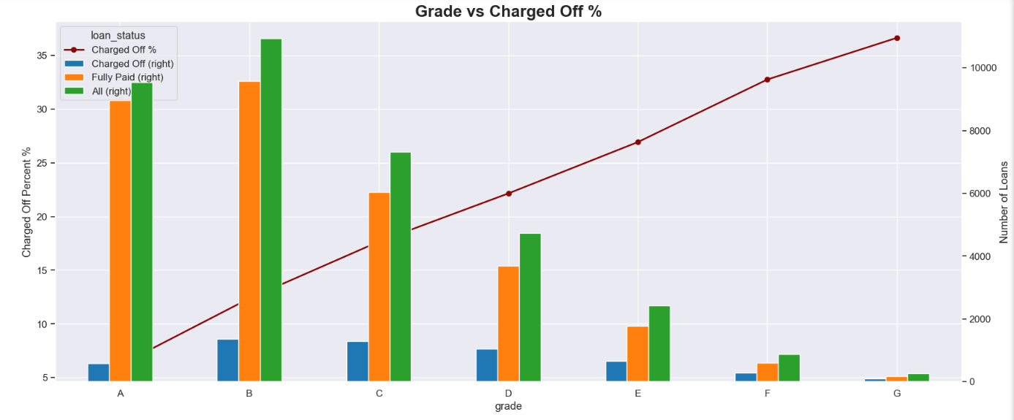
Multivariate Analysis

Slide 46
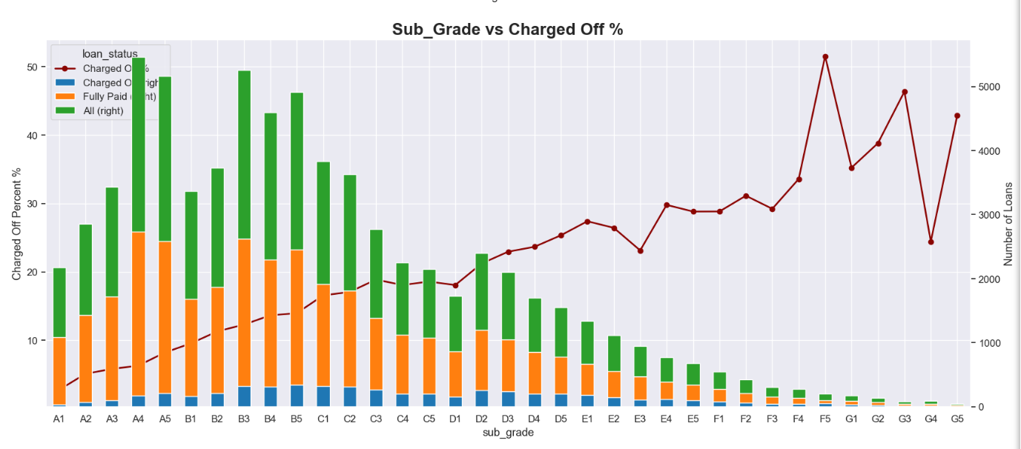
Multivariate Analysis

Slide 47
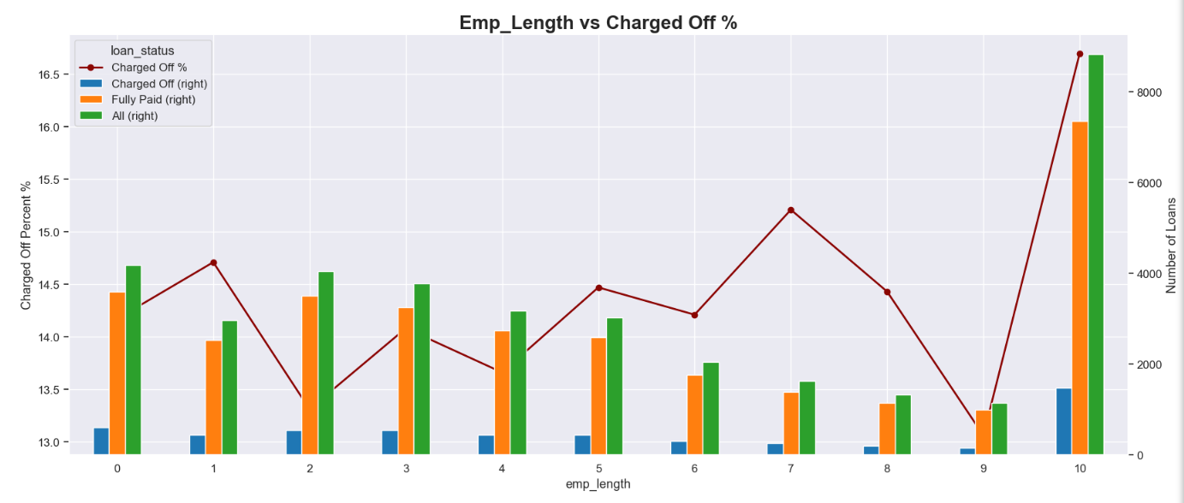
Multivariate Analysis

Slide 48
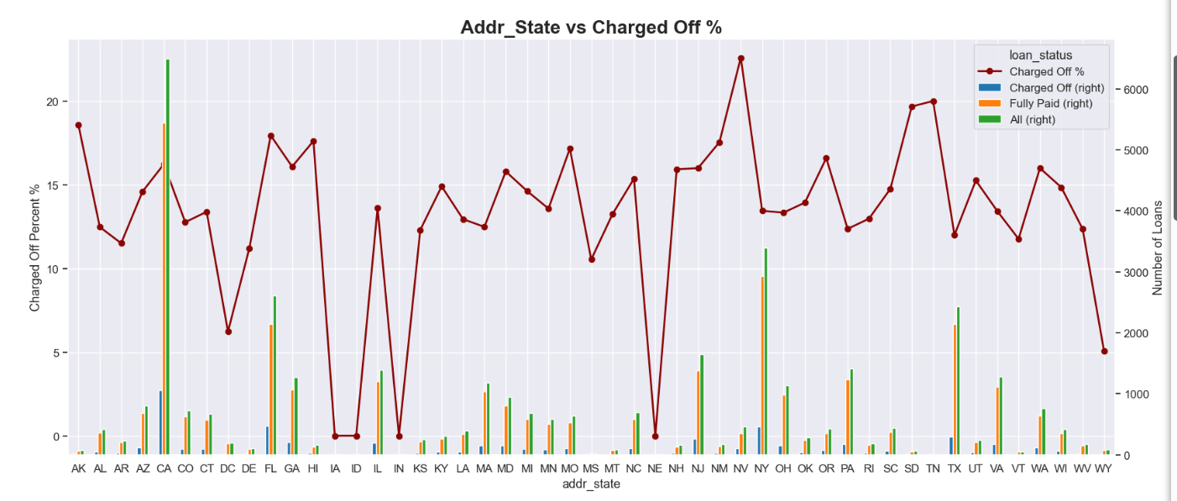
Multivariate Analysis

Slide 49
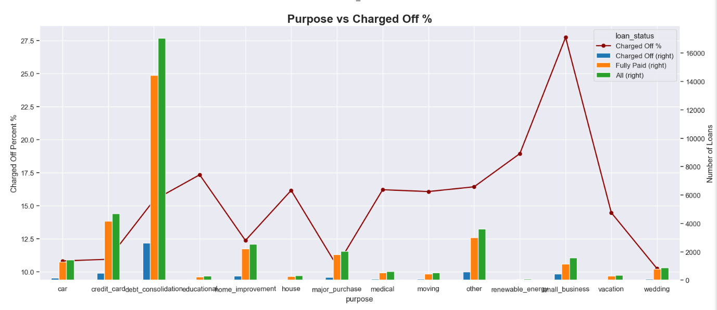
Multivariate Analysis

Slide 50
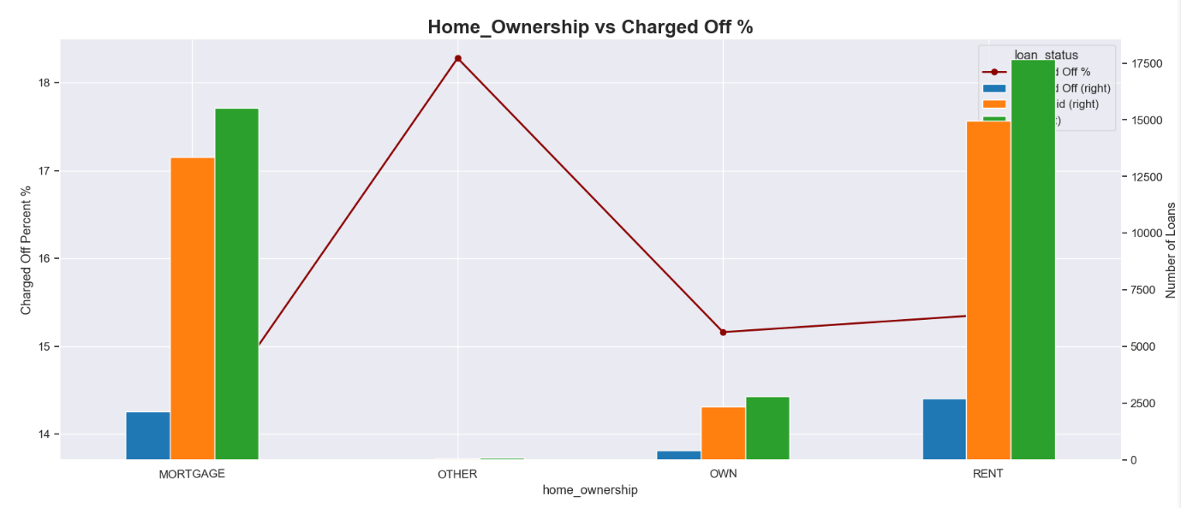
Multivariate Analysis

Slide 51
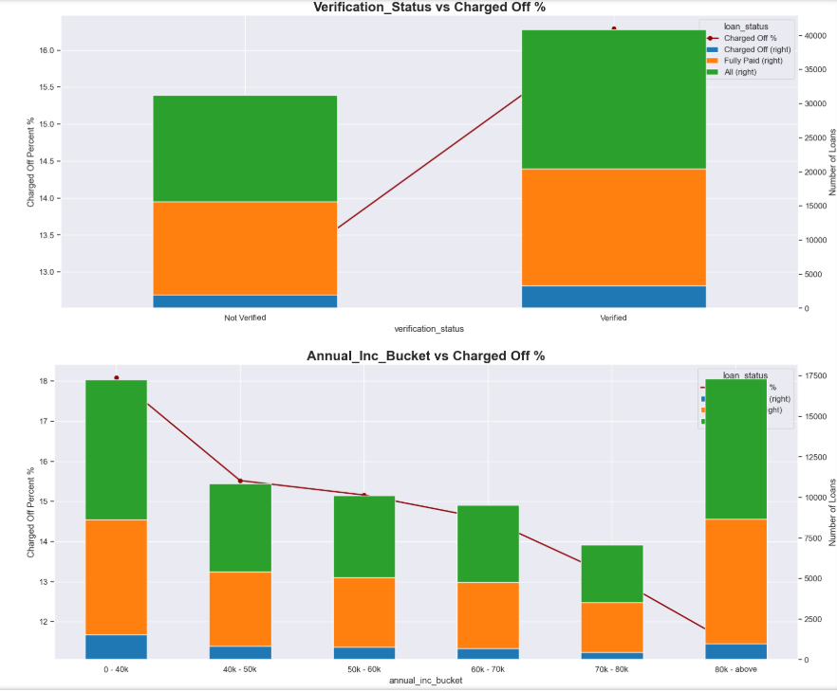
Multivariate Analysis

Slide 52
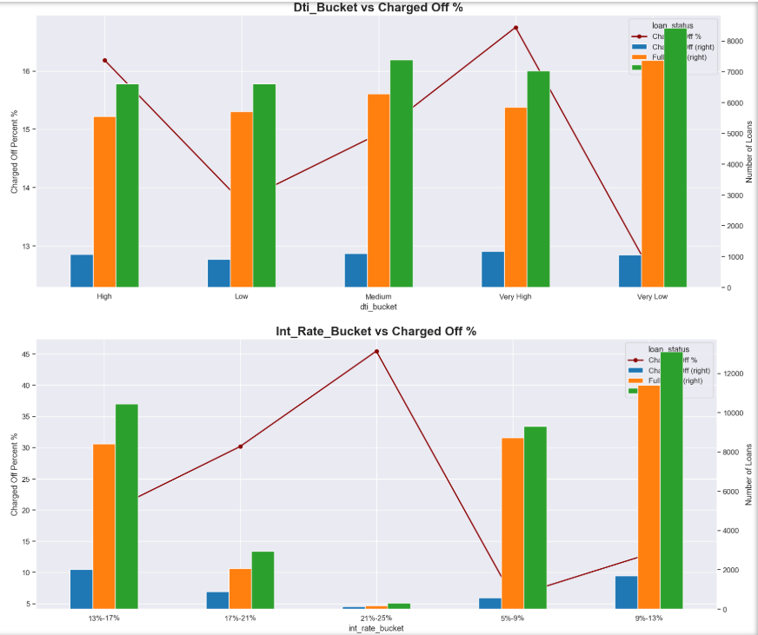
Multivariate Analysis

Slide 53
Multivariate Analysis - Insights
Summary of Multivariate Analysis
The likelihood of loan default increases as the interest rate rises.
Borrowers with 10 years of experience exhibit the highest tendency to default on their loans.
Borrowers from subgrades B3, B4, and B5 have the greatest propensity to default.
Loan applicants from states such as CA, FL, and NJ are more likely to default on their loans.
Individuals living in rented houses have the highest likelihood of defaulting on loans.
Borrowers in lower income brackets are more prone to default, with the default tendency generally decreasing as annual income increases.
Applicants belonging to credit grades B, C, and D are more likely to default on their loans.

Slide 54
Conclusion / Suggestions
Implement Stricter Criteria for Grades B, C, and D:
- Apply stricter risk assessment and underwriting criteria for applicants falling into Grades B, C, and D to minimize default risks.
Focus on Subgrades B3, B4, and B5:
- Pay special attention to applicants with Subgrades B3, B4, and B5.
- Consider additional risk mitigation measures, such as offering lower loan amounts for these subgrades to reduce default rates.
Evaluate and Limit 60-Month Loans:
- Evaluate the risk associated with 60-month loans.
- Consider limiting the maximum term or adjusting interest rates for longer-term loans to decrease the likelihood of defaults.
Comprehensive Credit Scoring System:
- Develop a comprehensive credit scoring system that incorporates various risk-related attributes.
- Relying on experience alone might not be sufficient to gauge creditworthiness.
Capitalizing on Market Growth:
- Capitalize on the market's growth trend observed from 2007 to 2011 by maintaining a competitive edge in the industry.
- Ensure robust risk management practices to safeguard against increasing risks.
Anticipate Peak Periods:
- Anticipate increased loan applications during peak periods such as December and Q4.
- Ensure efficient processing to meet customer demands during these busy seasons.
Careful Evaluation for Debt Consolidation Loans:
- Carefully evaluate applicants seeking debt consolidation loans.
- Consider potential interest rate adjustments or offering financial counseling services to manage the associated risks.

Slide 55
Conclusion / Suggestions
Consider Housing Stability:
- Take housing status into account during the underwriting process.
- Assess housing stability and its impact on the applicant's ability to repay the loan.
Review Verification Process:
- Review the verification process to ensure effective assessment of applicant creditworthiness.
- Consider improvements or adjustments based on the review findings.
Monitor & Adjust for Regional Risk Trends:
- Monitor regional risk trends, especially in states like California, Florida, and New York.
- Adjust lending strategies or rates accordingly in high-risk regions.
Thorough Assessment for High Loan Amounts:
- Conduct more thorough assessments for loan amounts of $15,000 or higher.
- Consider capping loan amounts for higher-risk applicants to mitigate potential defaults.
Adjust Interest Rates Based on DTI Ratios:
- Review the interest rate determination process and consider adjusting rates based on Debt-to-Income (DTI) ratios.
- Align rates with the borrower’s ability to repay.
Consider Income Levels for Affordability:
- Consider offering financial education resources and set maximum loan amounts based on annual incomes below $40,000.
- Ensure loan affordability for borrowers.

